Slide 1
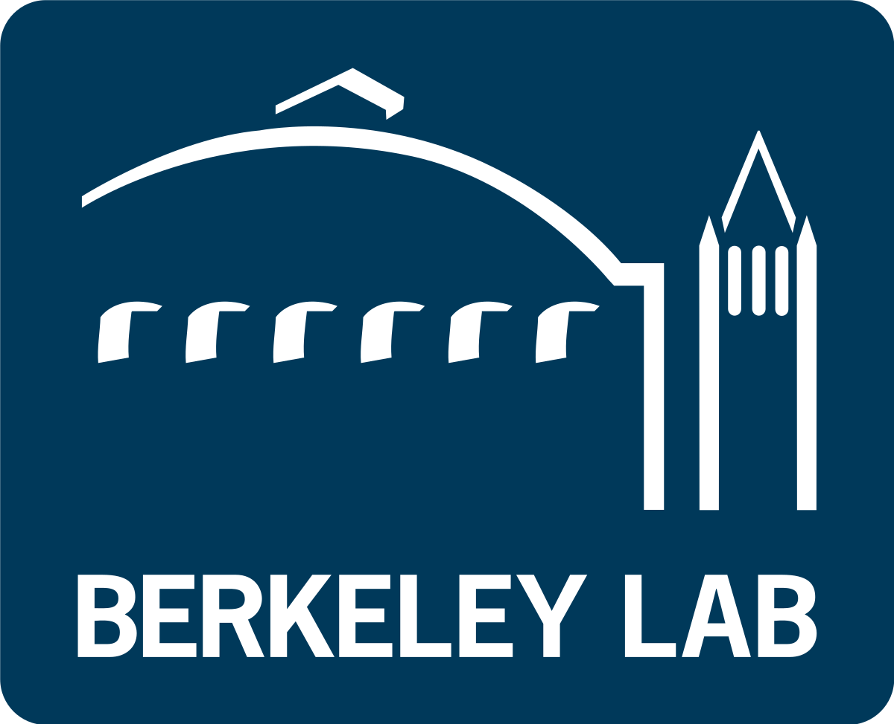




Scaling up semantics
lessons learned from across the life sciences
Chris Mungall
Lawrence Berkeley National Laboratory
cjmungall@lbl.gov
https://bit.ly/mungall-swat-23

Slide 2
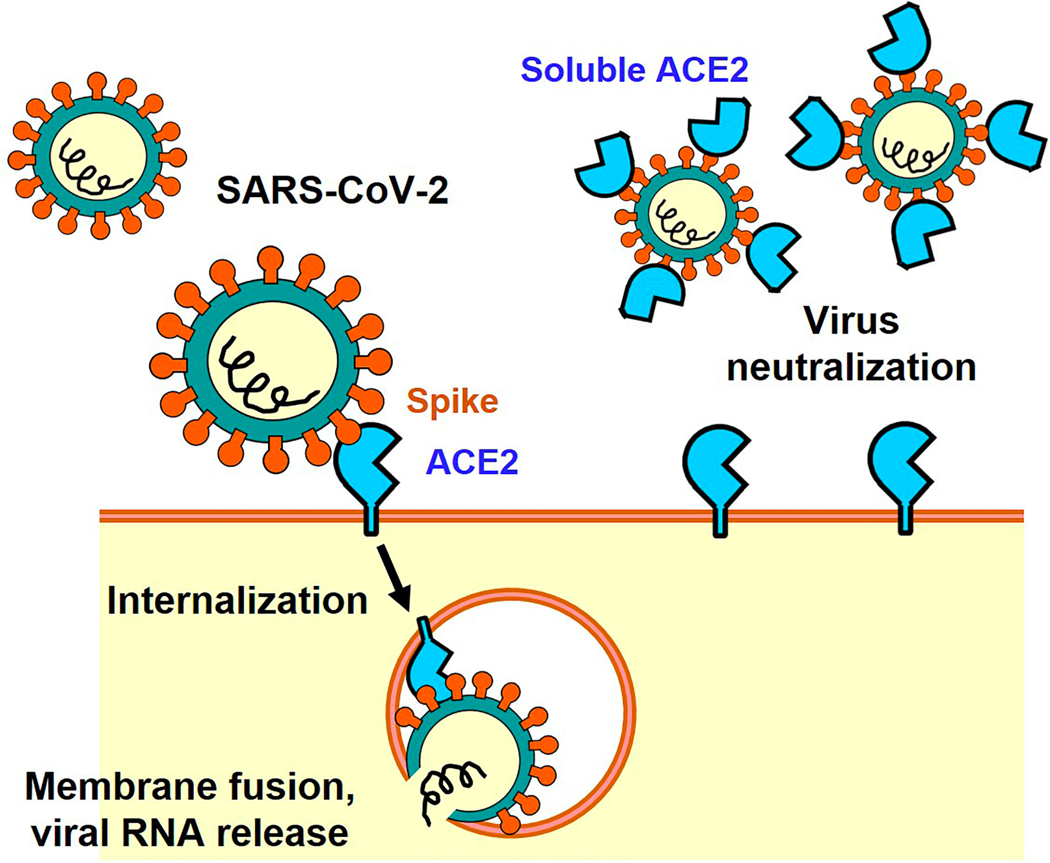
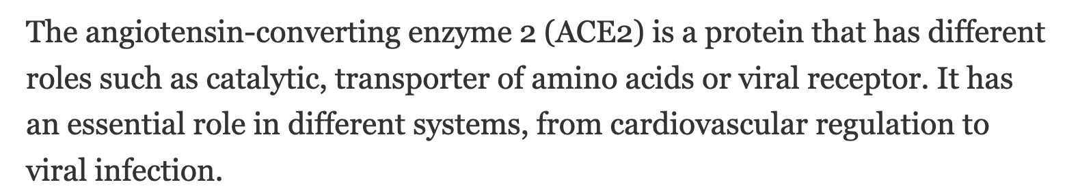

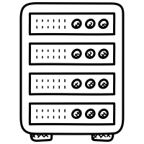
Providing Semantics for Systems Biology
The language of biological knowledge is text and images
Digestion into semantic models necessary to be properly understood by machines
❌
✅
Notes:
In the life sciences we are generating massive amounts of new data and knowledge, the way we communicate this knowledge is through words and pictures

Slide 3


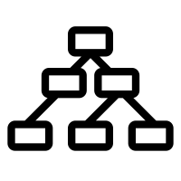

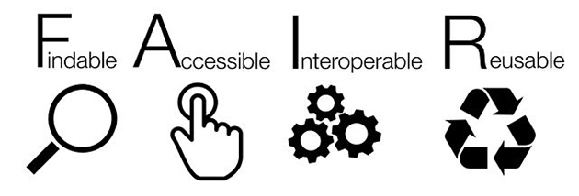
The Gene Ontology: Semantic Systems Biology
geneontology.org
45k classes
750,000 experimentally supported annotations manually curated from 140,000 publications
1bn computed annotations
❌
✅
✅
✅

Slide 4

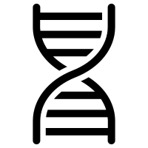

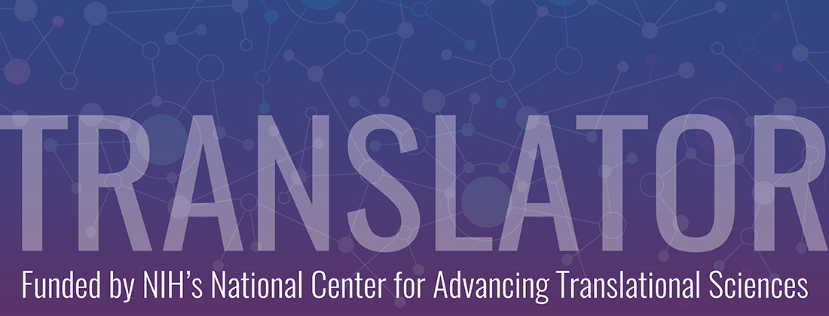






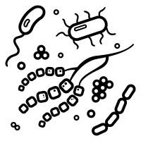

Semantic resources and life science applications
Molecular biology
Translational research and health
Microbiome science
multi-Omics integration
ontologies
Semantic resources
applications
semantic models
Notes:
TODO: add glyphs for genes, drugs, diseases, samples

Slide 5
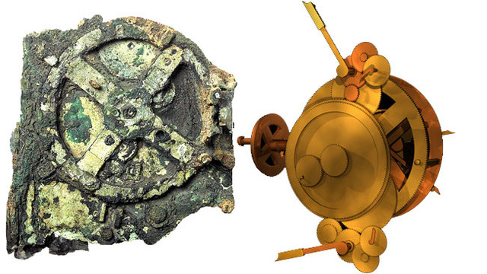
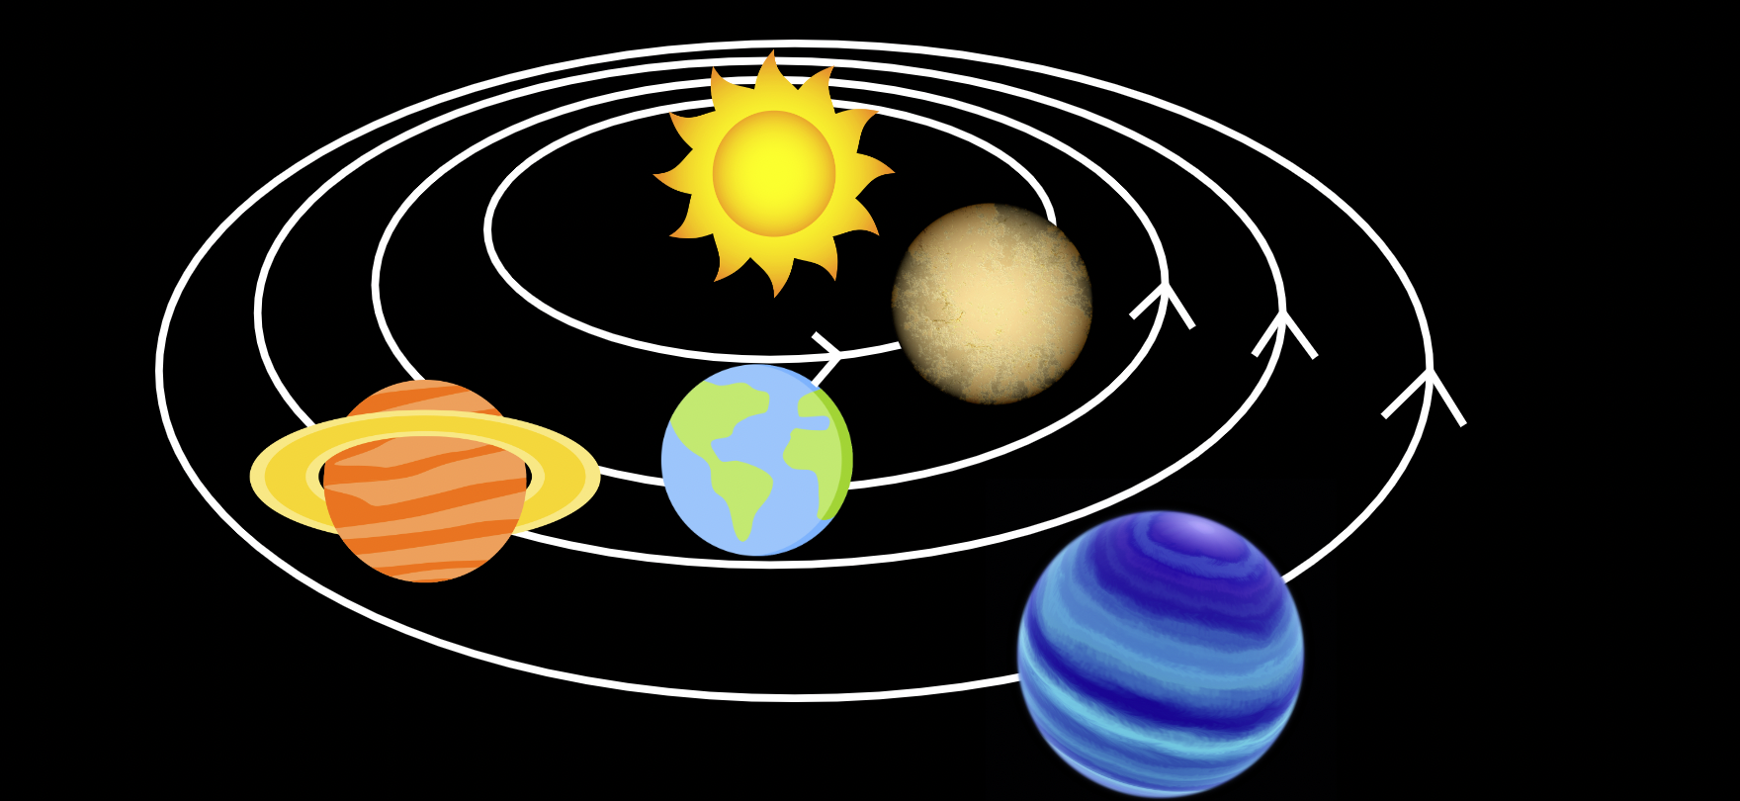
We have always sought to model the world
model of
https://en.wikipedia.org/wiki/Antikythera_mechanism

Slide 6
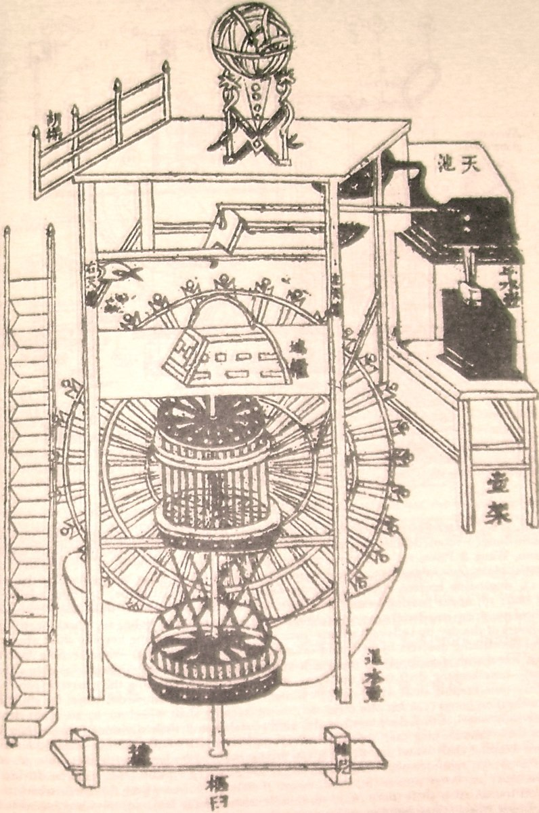

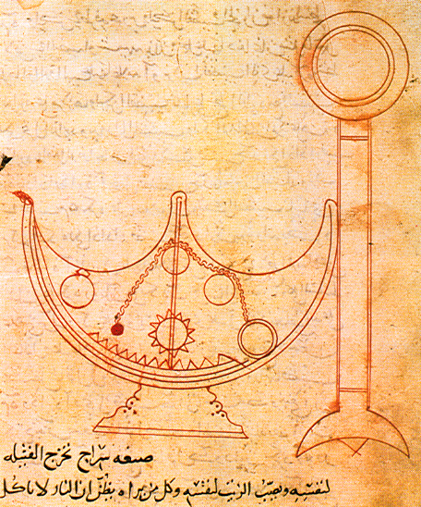
Preservation and rediscovery of knowledge
Notes:
TODO

Slide 7

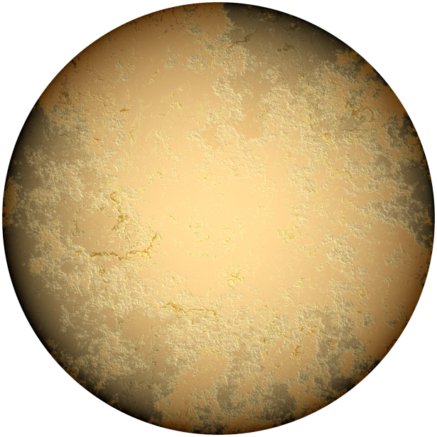



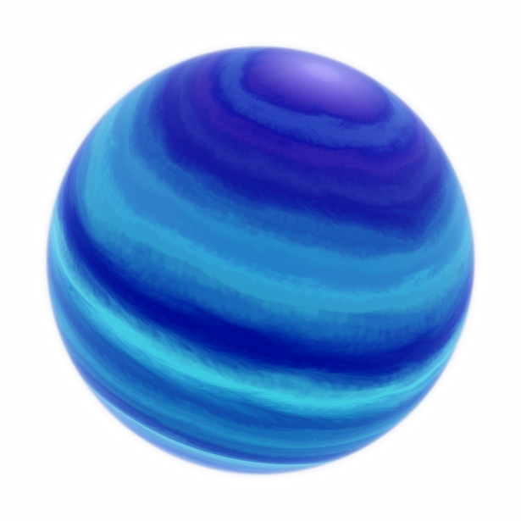
Modeling paradigms in the semantic solar system
LLMs
KGs
Schemas

Slide 8
Modeling paradigms in the semantic solar system
LLMs
KGs
Knowledge Graph planet
Model of things
Schemas

Slide 9
Modeling paradigms in the semantic solar system
LLMs
KGs
Knowledge Graph planet
Model of things
Schemas
Semantic schema planet
Model of information

Slide 10
Modeling paradigms in the semantic solar system
Large Language Model planet
Model of words
LLMs
KGs
Knowledge Graph planet
Model of things
Schemas
Semantic schema planet
Model of information

Slide 11
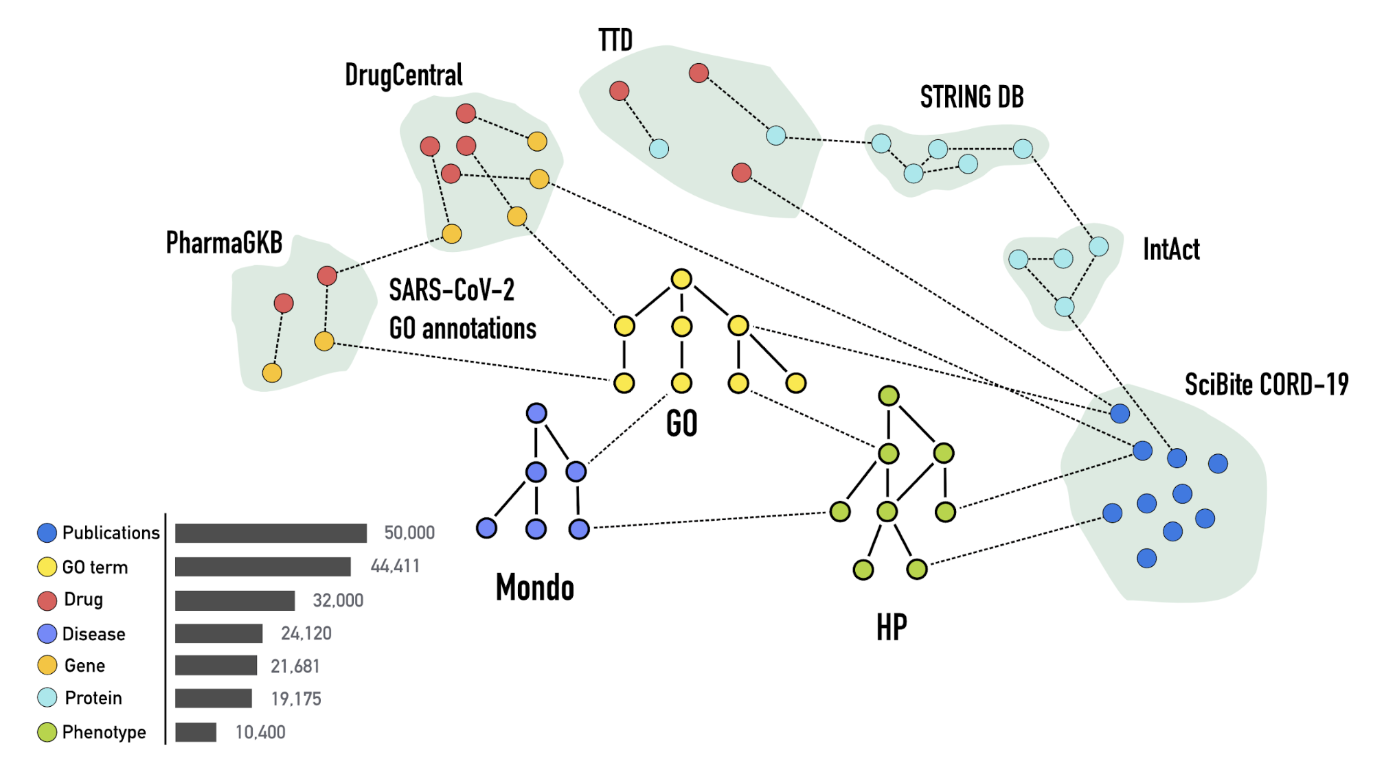
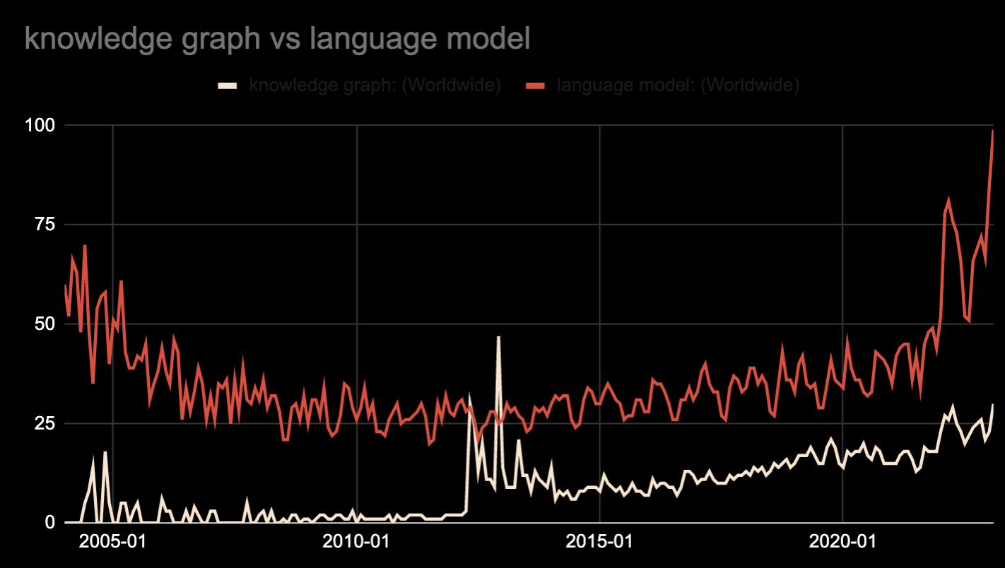
Planet KG: currently hot
Reese J, KG-COVID-19 10.1101/2020.08.17.254839
KGs
Knowledge Graph planet
Model of things
Temperature: hot
Notes:
TODO: chart should only show KG
TIMEPOINT: 5m

Slide 12
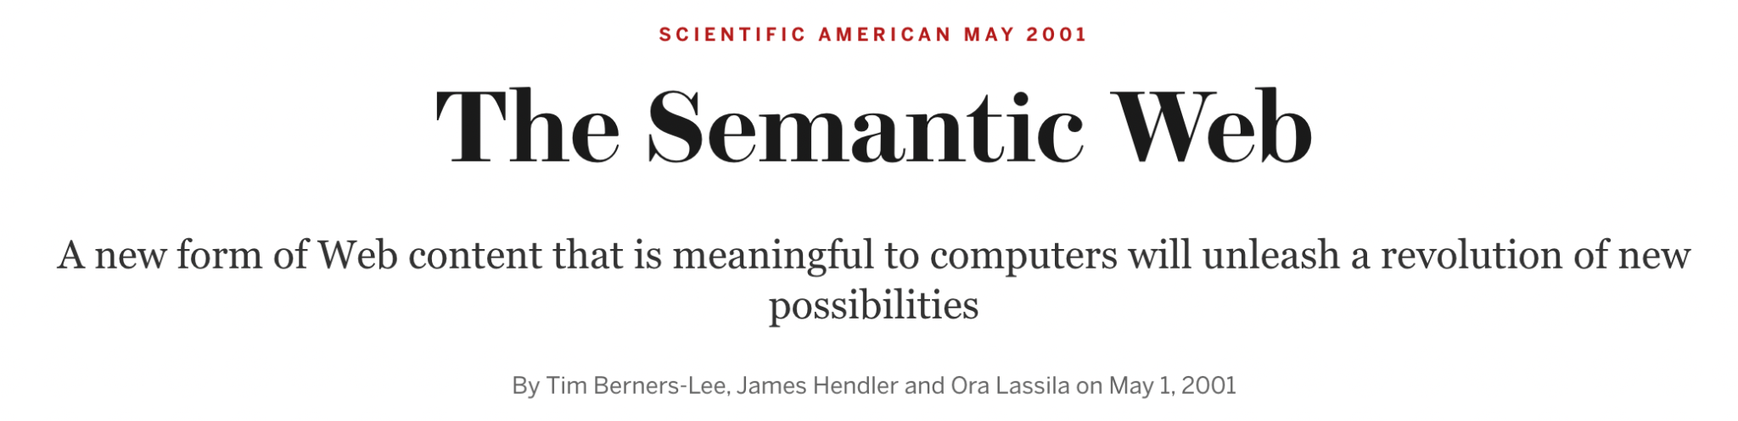
Previous iterations of KG planet: Semantic Web 2001
RDF
Differences:
Ad hoc IDs >> URIs
Scale >> Correctness
Property Graphs >> Triples
Graphs, ML >> Reasoning
Shiny databases >> Standards
Notes:
Limiting to see KGs purely as branding exercise: genuine difference in emphasis and communities

Slide 13
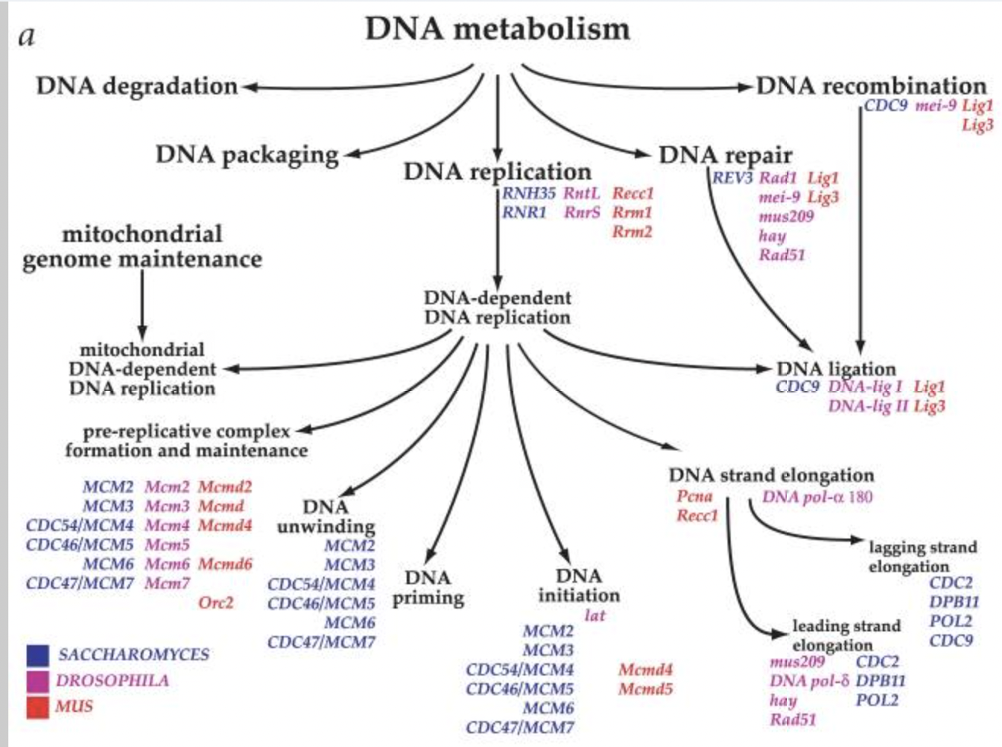
Previous iterations: bio-ontologies 1999->
Ashburner et al Gene Ontology: tool for the unification of biology. Nature Genetics 2000
GO
Differences:
All entities >> just terms
Quantity >> Quality

Slide 14

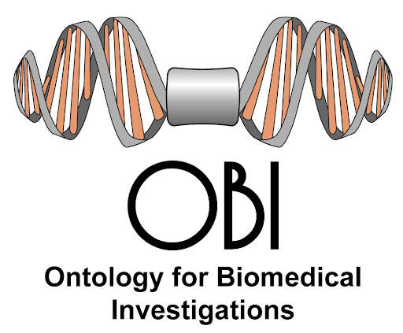


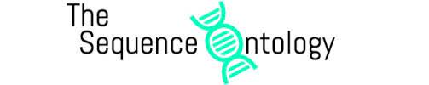

The interconnected OBO KG 2000->present
Diagnosing rare disease patients
15k citations/year
1 billion annotations
uses
Analyzing single-cell seq
You’re welcome!
Millions of environmental samples annotated
10-1000 billion annotations
obofoundry.org

Slide 15
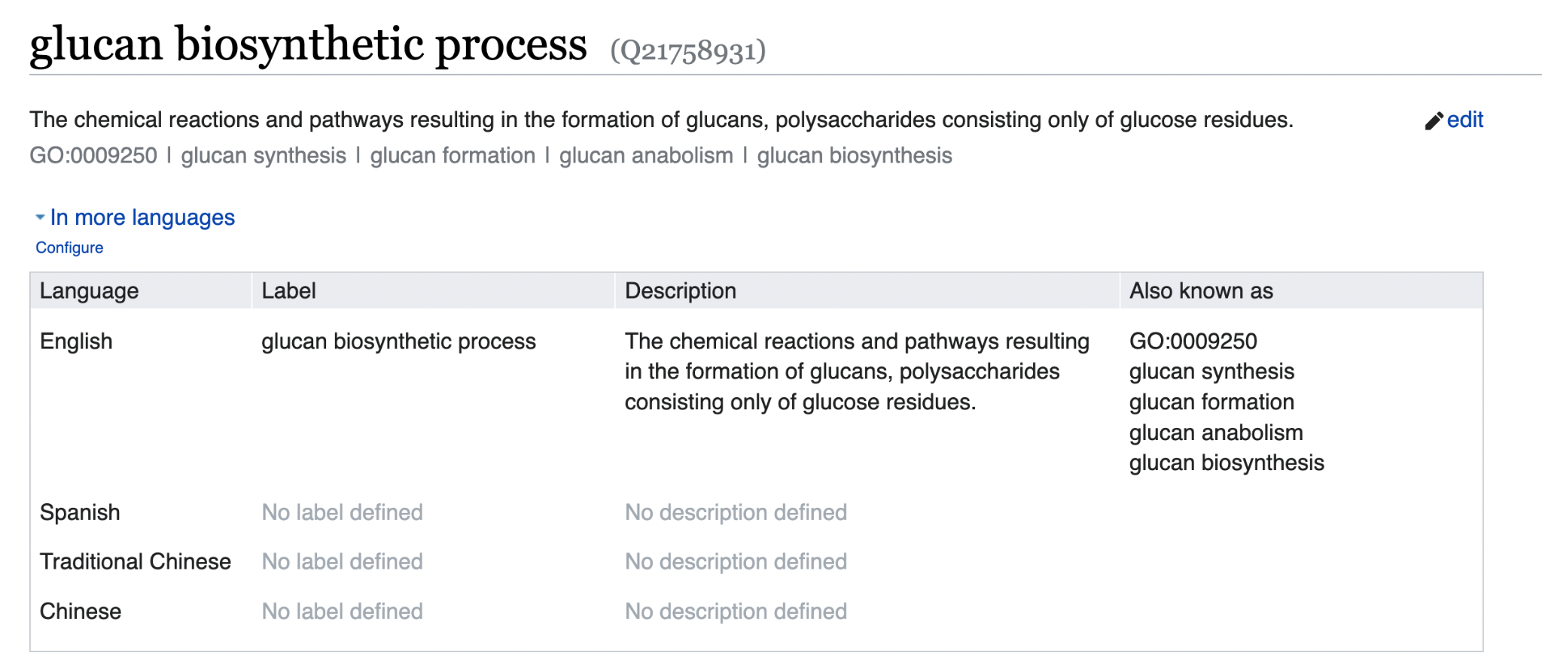
OBO and Wikidata
Notes:
TIMEPOINT: 10m

Slide 16
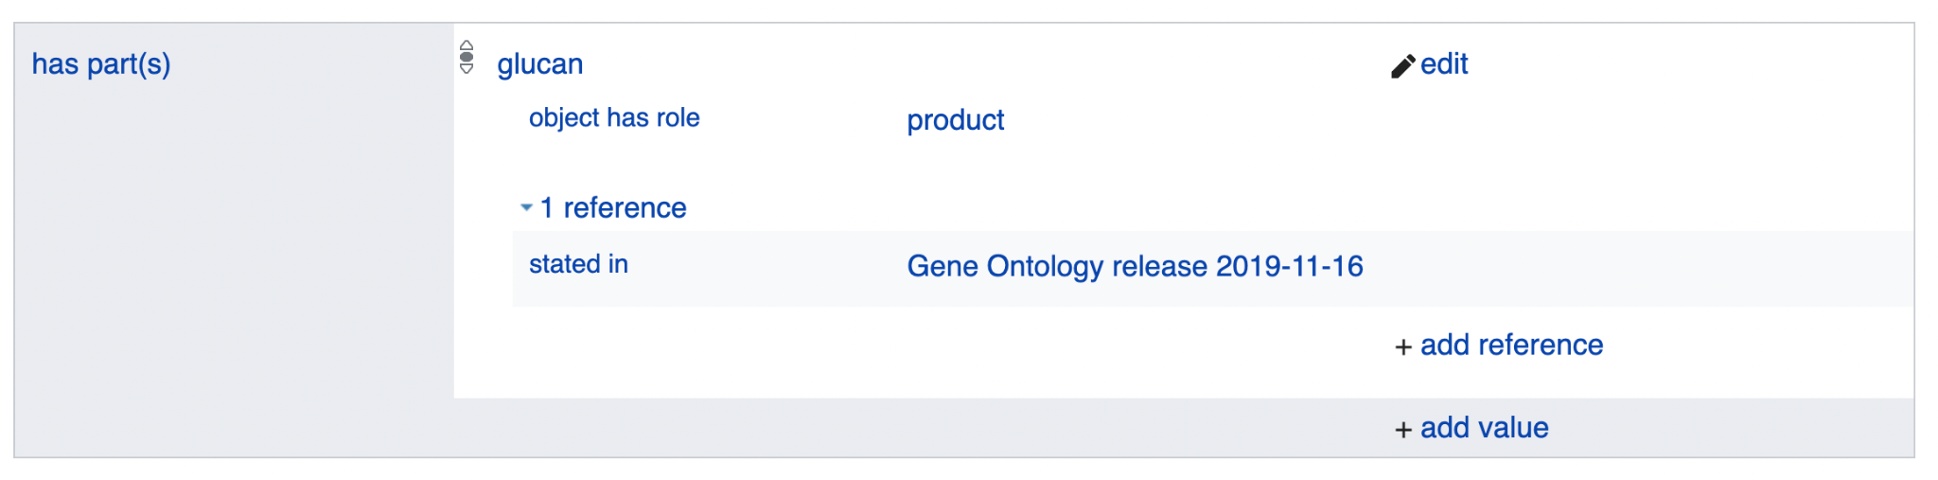
OBO and Wikidata

Slide 17

OBO and Wikidata
Many more OBO ontologies to go!
Join us on #wikidata on OBO slack
http://obofoundry.org
Next up:
Environment Ontology (ENVO)
H
Join

Slide 18
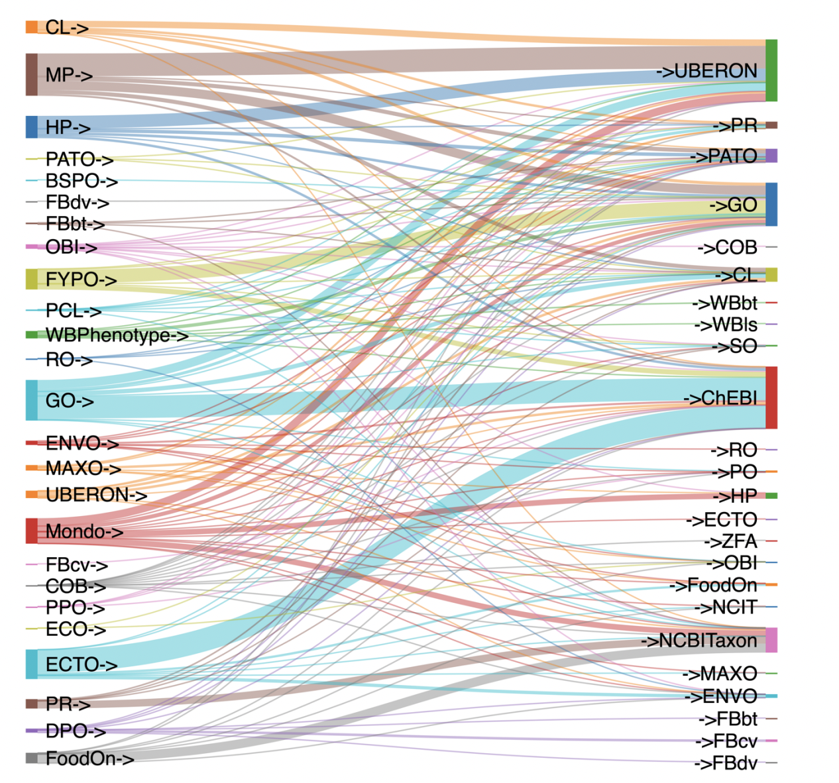
OBO KG in Ubergraph
Triplestore with interlinked subset of OBO
Inference pre-entailed using Relation Graph
Pre-categorized using Biolink
Powerful federated queries with uniprot, wikidata, others
https://ubergraph.apps.renci.org/sparql
https://github.com/INCATools/ubergraph
Inter-ontology connections in Ubergraph, grouped by OBO ontology
https://icbo-conference.github.io/icbo2022/papers/ICBO-2022_paper_5005.pdf

Slide 19
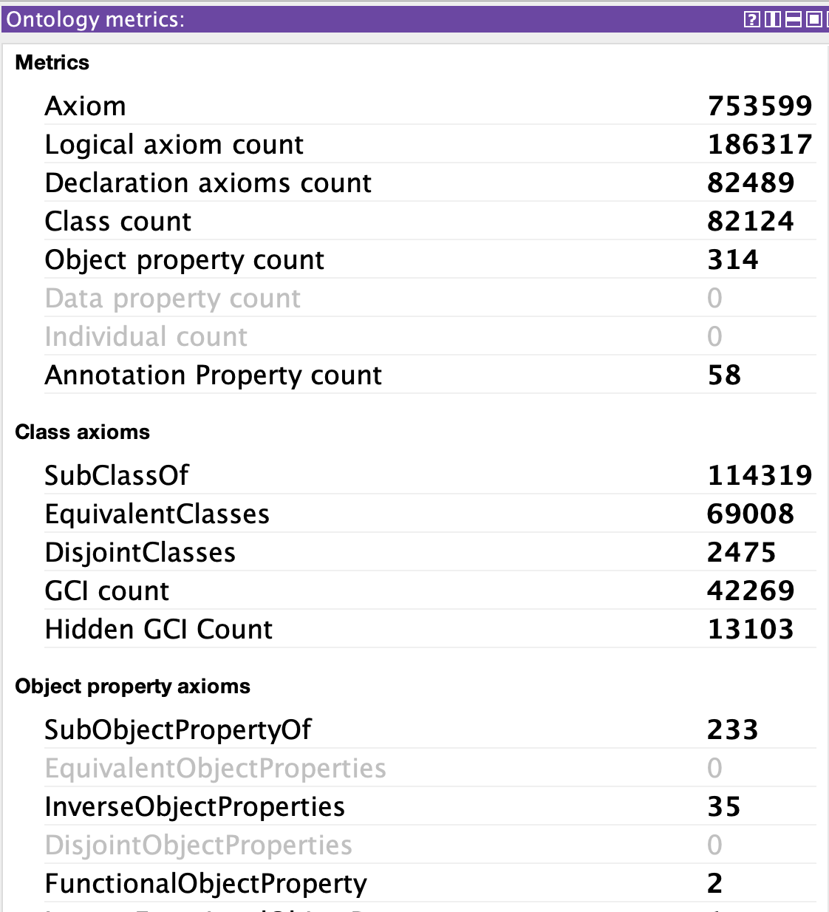

Use of semantics in the connected KG
polysaccharide biosynthesis
(GO:0000271)
biosynthesis
(GO:0009058)
≡
⊓
∃.has_output
polysaccharide
(CHEBI:18154)
Inferred by
OWL reasoner
⊑
⊑
biosynthesis
(GO:0009058)
glucan biosynthesis
(GO:0009250)
⊓
≡
∃.has_output
glucan
(CHEBI:37163)
Notes:
This paradigm now used throughout OBO

Slide 20
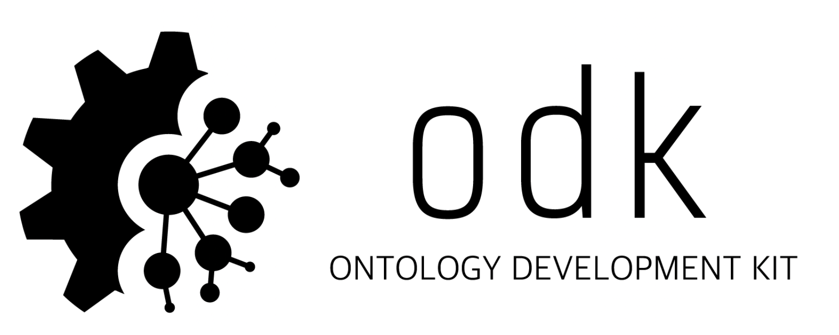
Ontology Development Kit (ODK)
ODK makes it easy to create a new GitHub repo following best practice + automation
standardized, customizable and automatically executable workflows, and packages all required tooling in a single Docker image
Matentzoglu et al (2022) Ontology Development Kit: a toolkit for building, maintaining and standardizing biomedical ontologies. Database 10.1093/database/baac087
https://incatools.github.io/ontology-development-kit
NEW: Ontology Access Kit (OAK). Python library for working with ontologies https://incatools.github.io/ontology-access-kit
Notes:
TIMEPOINT: 15m

Slide 21
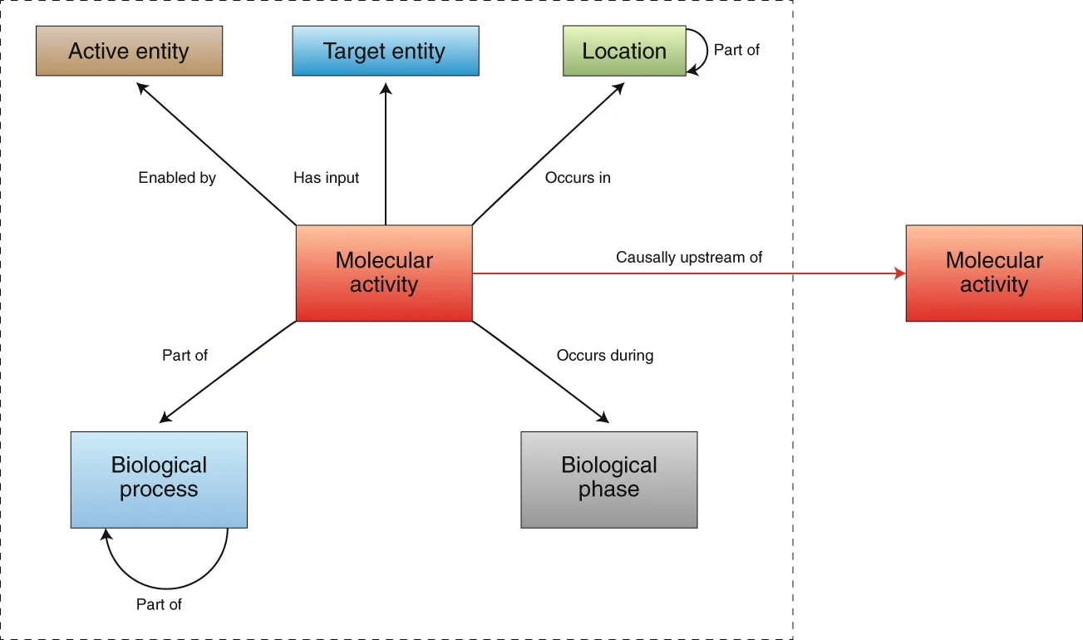
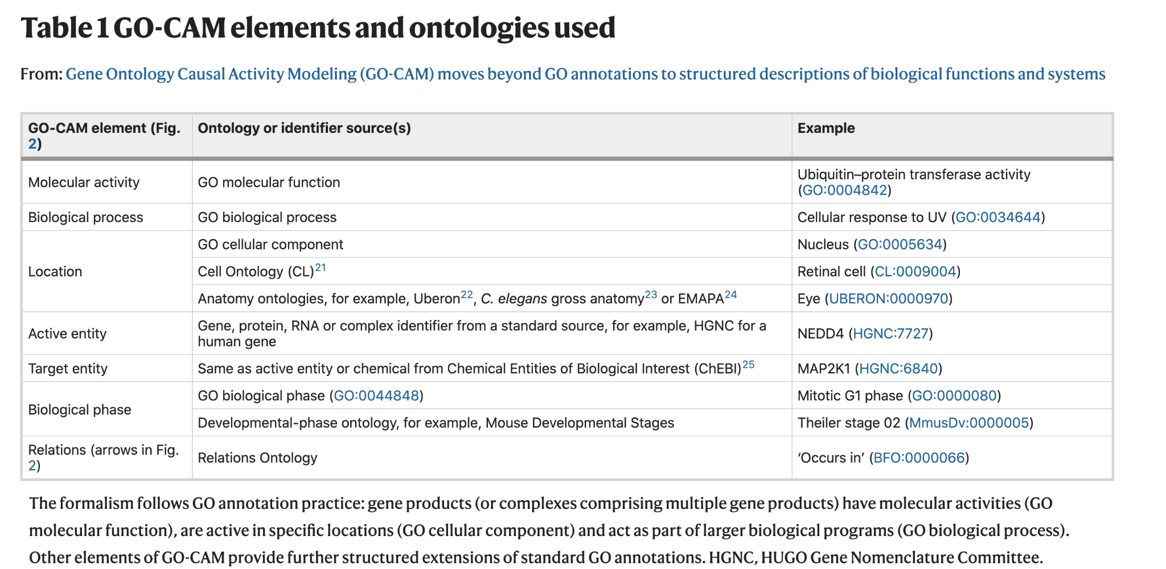
Gene Ontology
Causal Activity Models:
Systems KGs
Thomas, PD (2019): Gene Ontology Causal Activity Modeling (GO-CAM) moves beyond GO annotations to structured descriptions of biological functions and system. Nat Gen PMC7012280

Slide 22
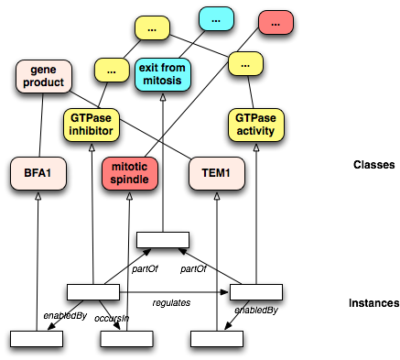
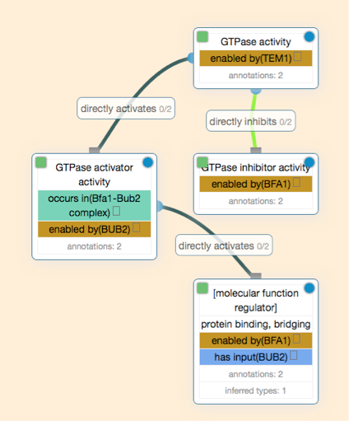
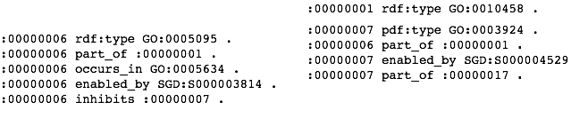
Biologist View
RDF view
http://rdf.geneontology.org/ - SPARQL endpoint

Slide 23
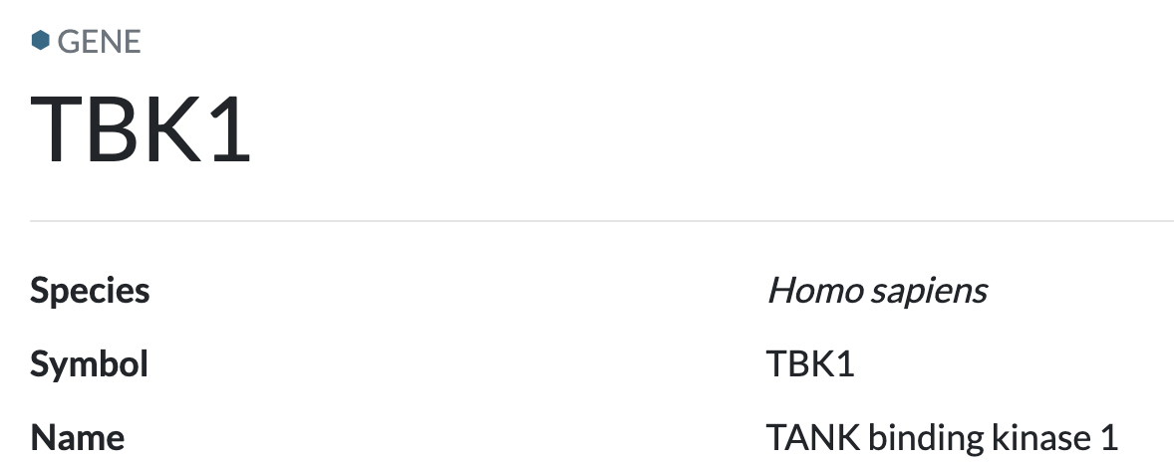
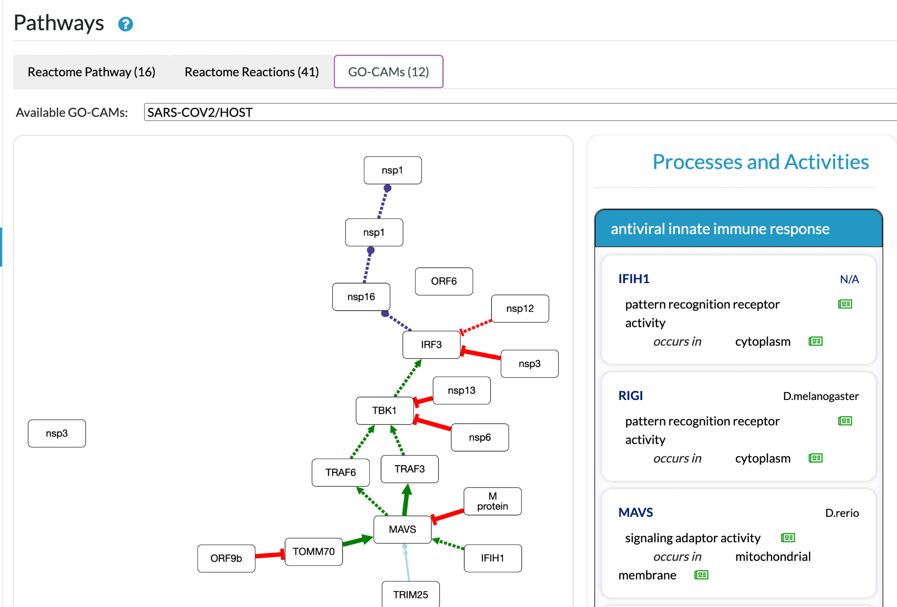
Pathway views on Alliance gene pages
https://www.alliancegenome.org/gene/HGNC:11584

Slide 24
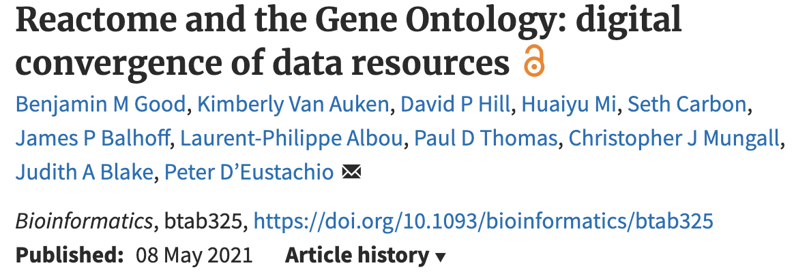
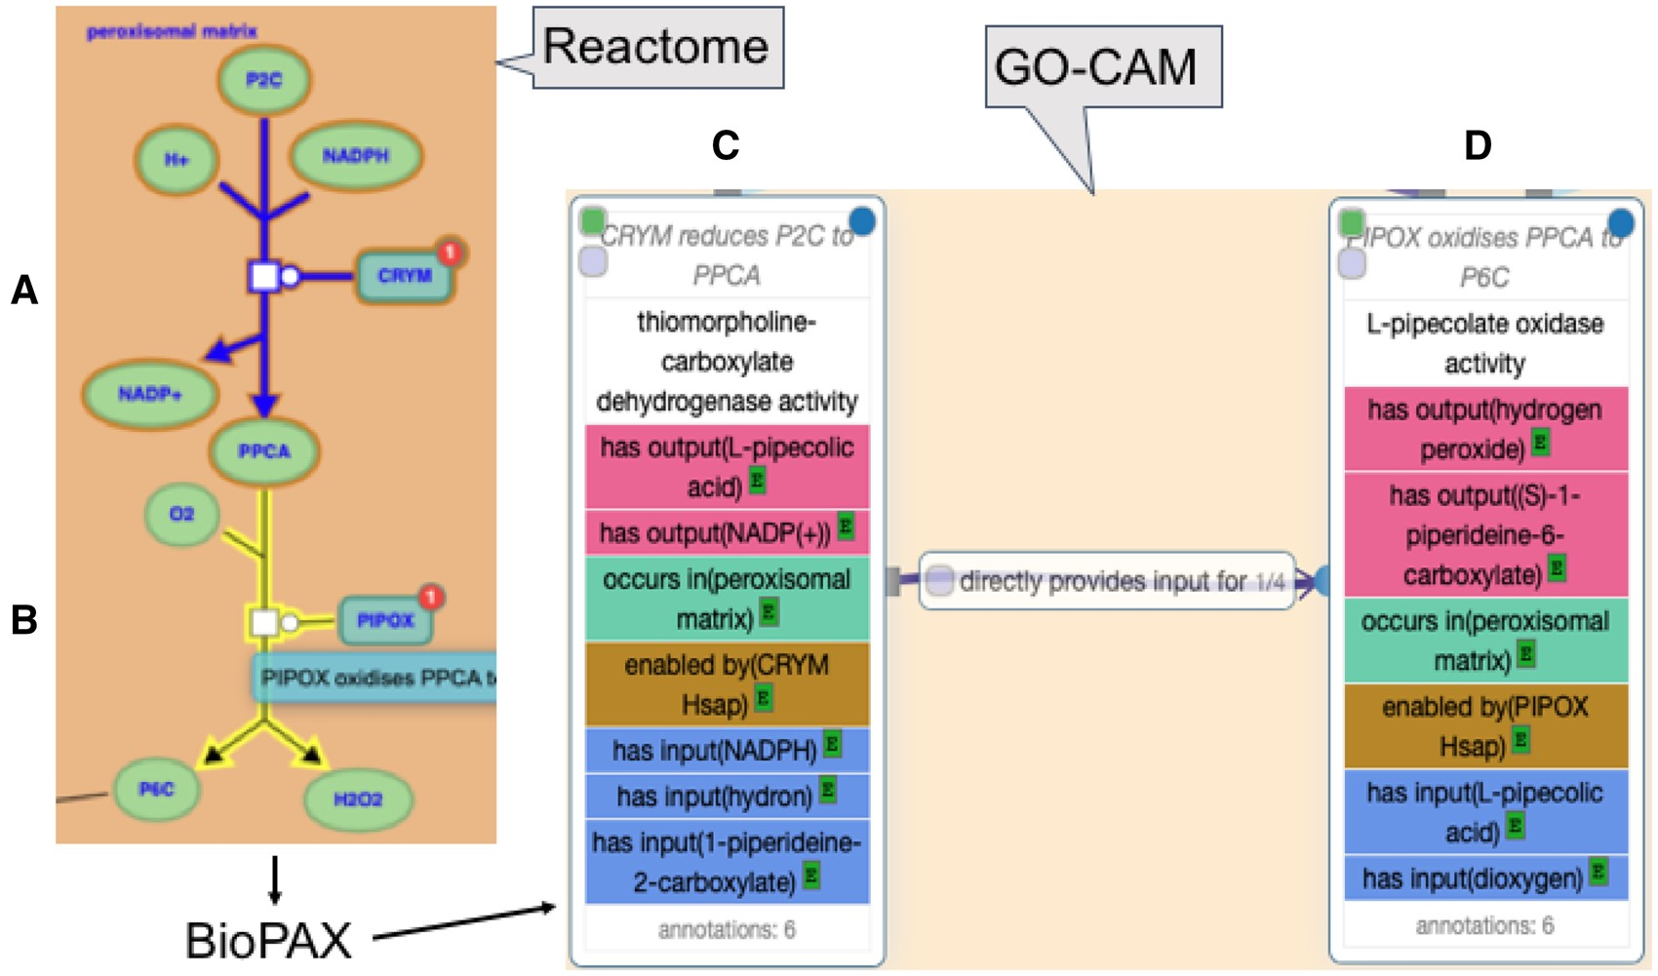

Slide 25
Previous iterations of planet KG
Semantic
Nets
Knowledge Representation with graphs didn’t start with the semantic web and ontologies…

Slide 26
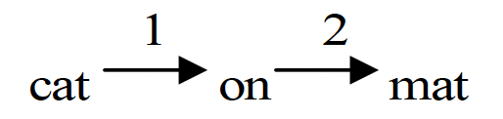
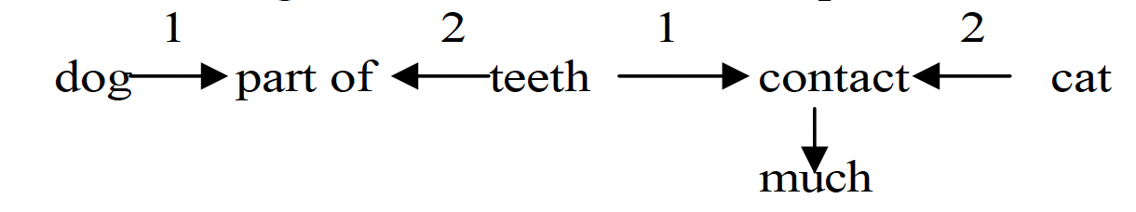
Previous iterations: 1950s KGs
Richens RH, "Preprogramming for mechanical translation" Mechanical Translation 3 (1), July 1956, 20–25
“The cat is on the mat”
Semantic
Nets
Differences:
Emphasis on language
Applications: Machine Translation
“The cat is bitten by the dog”

Slide 27
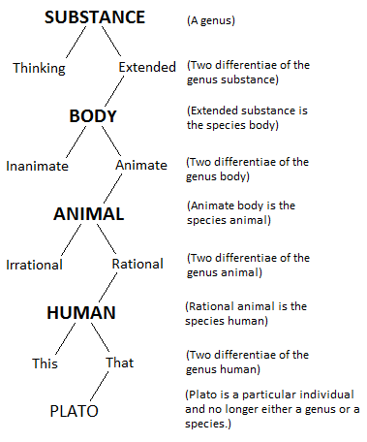
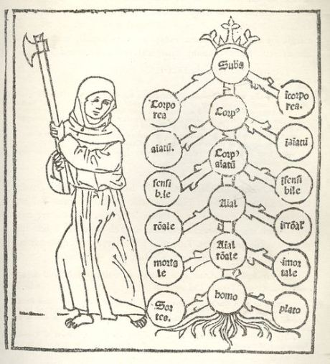
Previous iterations: KGs in the 3rd century CE
Poryphrian Trees
Differences:
Philosophical inquiry >> Computation
Theology >> science or empiricism

Slide 28
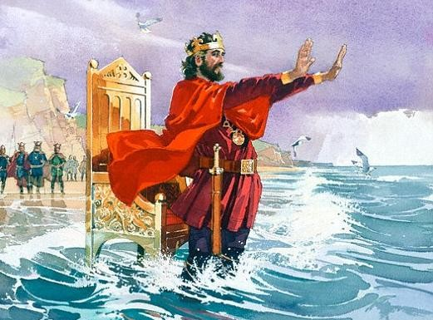
Curse of the eternal return
Ontologies
RDF
KGs
Notes:
TODO: emphasize circularity more in figure
TIMEPOINT: 20m

Slide 29

Curse of the eternal return
Ontologies
RDF
KGs
Notes:
TODO: emphasize circularity more in figure
opportunity

Slide 30
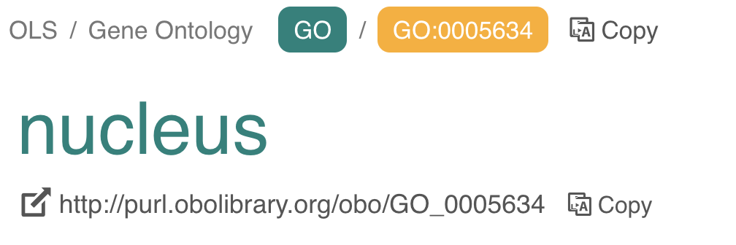
Embrace CURIEs
URI are rarely used as identifiers outside RDF frameworks
URIs are awkward to work with outside RDF tooling
Solution: CURIEs
Prefixed IDs have been standard in bio-databases before RDF
GO:0005634
UniProtKB:P12345
Key: always make the prefixmap explicit
Hoyt, C. T., et al. (2022) The Unifying the identification of biomedical entities with the Bioregistry. Nature Scientific Data, s41597-022-01807-3
https://bioregistry.io/
https://github.com/linkml/prefixmaps/
Notes:
TODO: tidy

Slide 31
Can we have semantics in our KGs?
The story:
RDF and OWL provide semantics for the web
The reality:
OWL is great for terminology maintenance
OWL layering in RDF is problematic and ignored in non-RDF KGs
OWL is a poor fit for contingent knowledge common in the life sciences

Slide 32
Example: semantics of parthood
Doesn’t capture quantification
:Galaxy
:partOf
:SolarSystem
:partOf
:Planet

Slide 33
Example: semantics of parthood in OWL
Class: Planet
SubClassOf: partOf some SolarSystem
Class: SolarSystem
SubClassOf: partOf some Galaxy

Slide 34
RDF/OWL Ontology Rendering
:Galaxy
Complex monstrosity
Misaligned with mental model
Confuses developers
Not amenable to transitive/graph querying
E.g. what kinds of things are found in galaxy?
owl:Restriction
owl:someValuesFrom
rdf:type
<blank>
owl:onProperty
rdfs:subClassOf
:SolarSystem
:partOf
rdf:type
owl:someValuesFrom
owl:onProperty
<blank>
rdfs:subClassOf
:Planet
Notes:
TIMEPOINT: 25m

Slide 35
OWLStar Property Graph conceptual model
:Galaxy
Simple view (as used in Wikidata)
:partOf
:SolarSystem
:partOf
:Planet
https://github.com/linkml/owlstar

Slide 36
OWLStar Property Graph conceptual model
:Galaxy
Simple view (as used in Wikidata)
:partOf
owlstar:interpretation
:SolarSystem
owlstar:SomeValuesFrom
owlstar:interpretation
:partOf
Decorate with semantics
Assumes Property Graph
Decoration can be deferred
:Planet
https://github.com/linkml/owlstar

Slide 37
OWLStar Property Graph in RDFStar
:Galaxy
:partOf
owlstar:interpretation
:SolarSystem
owlstar:SomeValuesFrom
owlstar:interpretation
:partOf
<<:Planet :part-of :SolarSystem>> owlstar:interpretation owlstar:AllSomeInterpretation .
<<:SolarSystem :part-of :Galaxy>> owlstar:interpretation owlstar:AllSomeInterpretation .
:Planet
https://github.com/linkml/owlstar

Slide 38
OWLStar Property Graph in OneGraph
:Galaxy
:partOf
owlstar:interpretation
:SolarSystem
owlstar:SomeValuesFrom
owlstar:interpretation
:partOf
Coming Soon: OneGraph layering
:Planet
https://github.com/linkml/owlstar

Slide 39
Semantics of contingent knowledge in KGs
FOL/model theory is the basis of RDF and OWL
… yet is a poor fit for much biological knowledge
See:
Schulz S: Strengths and limitations of formal ontologies in the biomedical domain PMC2904529
Rector A: On beyond Gruber: "Ontologies" in today's biomedical information systems and the limits of OWL PMID34384571
Schulz S: “Lmo-2 interacts with Elf-2” On the Meaning of Common Statements in Biomedical Literature KRMED 2006
:lmo-2
:elf-2

Slide 40
A new old logic layered on Property Graphs
Multimodal semantics:
Use whatever the use case demands
Defeasible reasoning, bayesian probabilities, …
Or simply defer
<< your semantics here>>
:lmo-2
:elf-2
https://github.com/linkml/owlstar
Notes:
TIMEPOINT: 30m

Slide 41
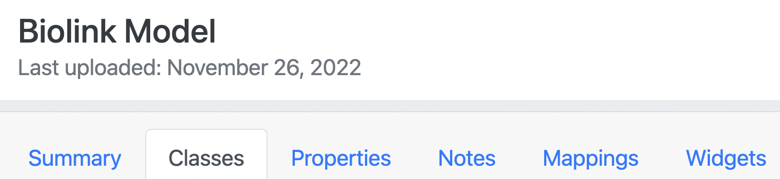
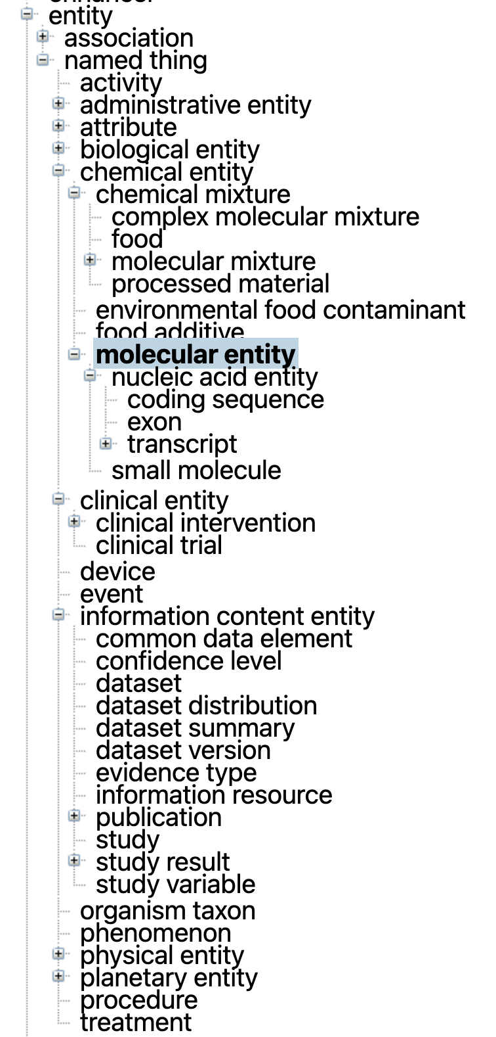
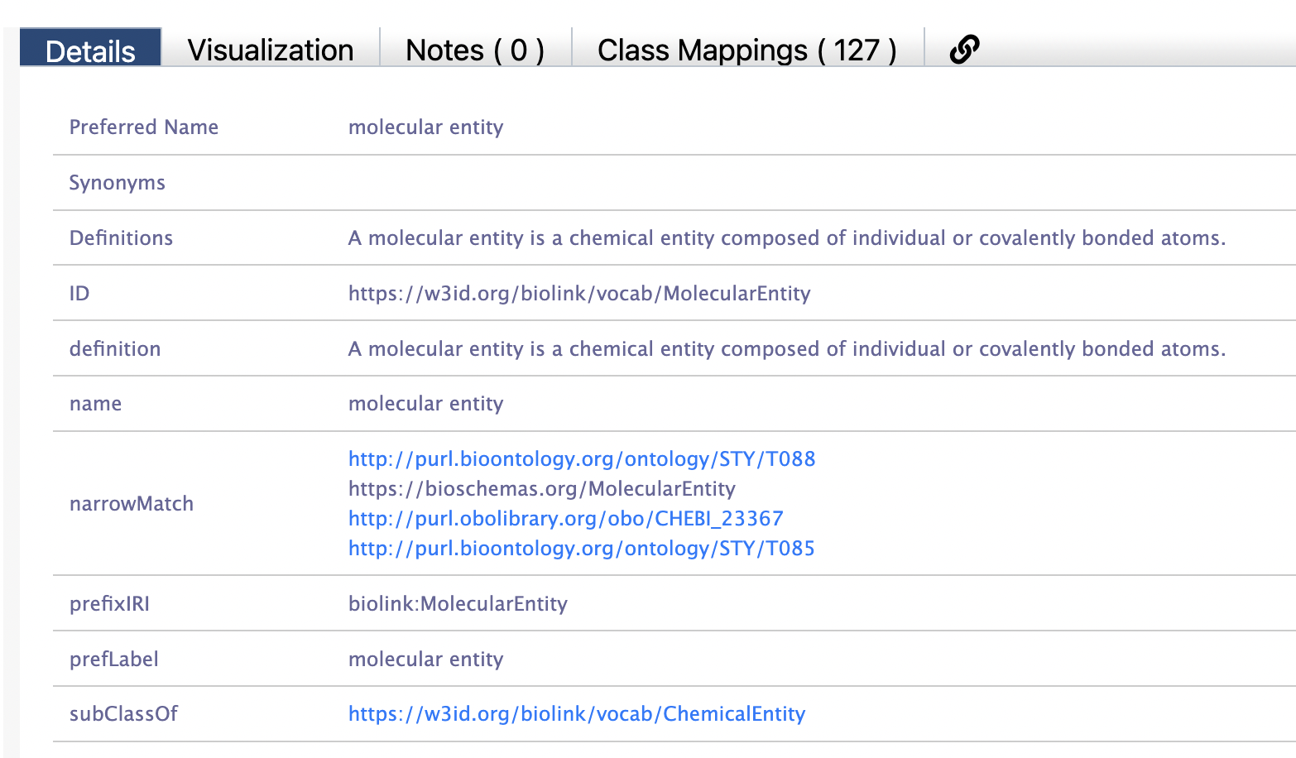
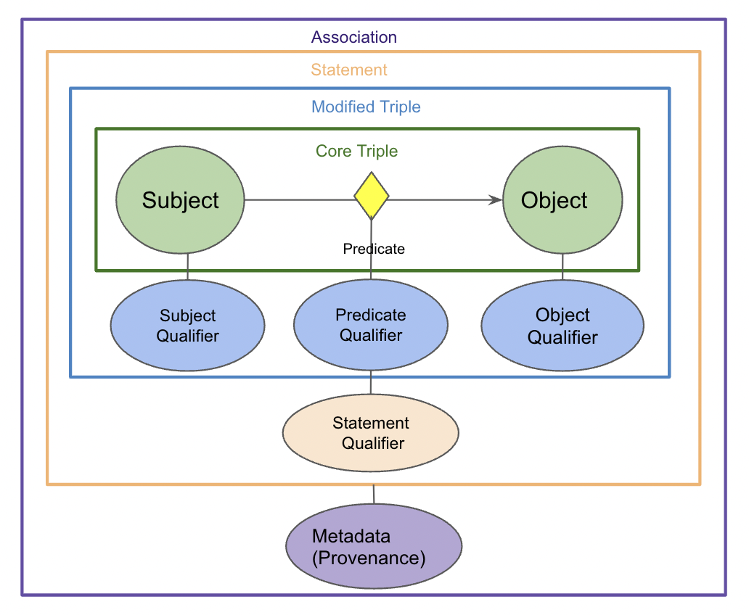
BioLink Model: hierarchical categories for KGs
Unni D et al (2022). Biolink Model: A universal schema for knowledge graphs in clinical, biomedical, and translational science. Clin. Tran. Sci
https://w3id.org/biolink

Slide 42
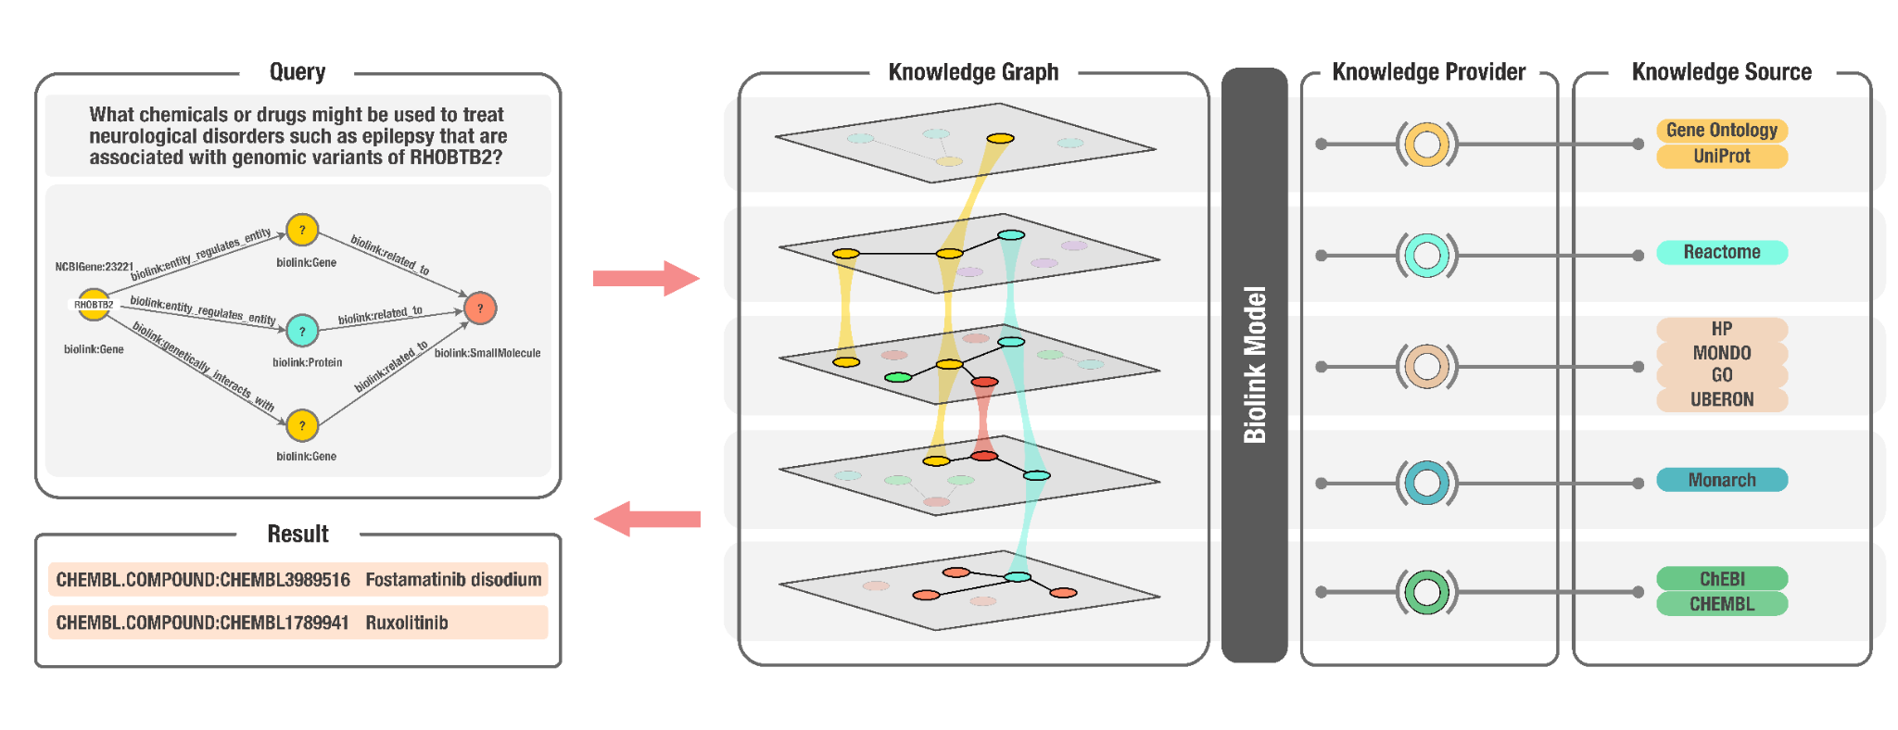
Standards in NCATS Biomedical Translator
Notes:
Should back to Elif’s talk.
Figure 3: A conceptual overview of the Translator Consortium use case and implementation plan. Variants of the gene RHOBTB2 cause epilepsy, learning difficulties, and movement disorders, presumably due to an accumulation of RHOBTB2 protein. In order to learn more about the relationship between RHOBTB2 and neurological disorders, including potential drug treatment, investigators would typically need to review data and publications from multiple resources–a manual, time-consuming, and often challenging process due to incompatibilities in data models. In Translator, data is normalized to Biolink Model such that users can pose queries and rapidly receive harmonized answers derived from independent data sources.

Slide 43
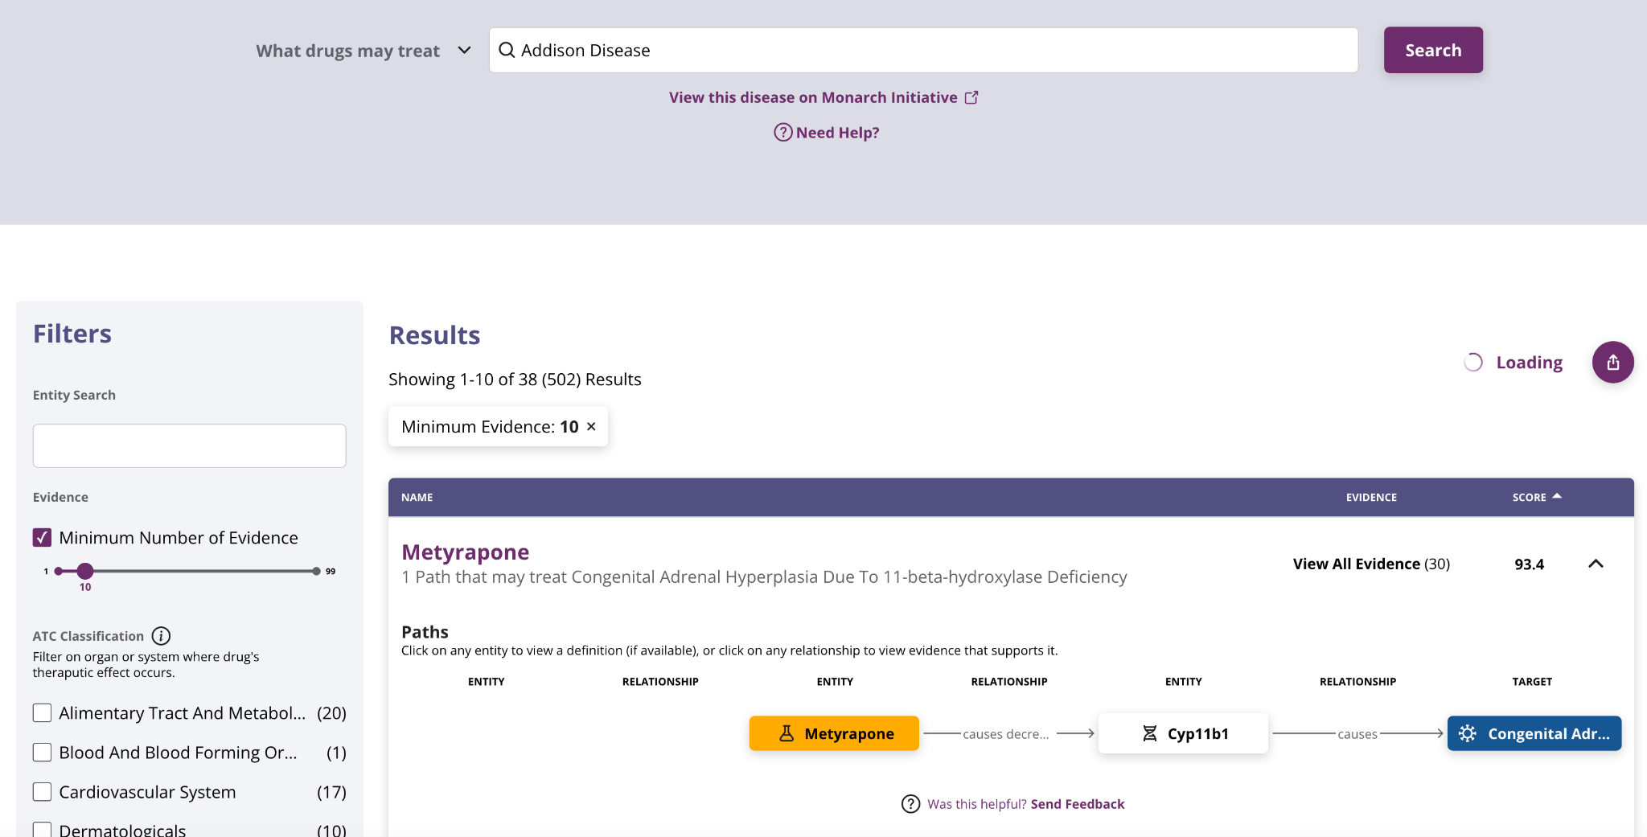
Standards in NCATS Biomedical Translator
Notes:
Figure 3: A conceptual overview of the Translator Consortium use case and implementation plan. Variants of the gene RHOBTB2 cause epilepsy, learning difficulties, and movement disorders, presumably due to an accumulation of RHOBTB2 protein. In order to learn more about the relationship between RHOBTB2 and neurological disorders, including potential drug treatment, investigators would typically need to review data and publications from multiple resources–a manual, time-consuming, and often challenging process due to incompatibilities in data models. In Translator, data is normalized to Biolink Model such that users can pose queries and rapidly receive harmonized answers derived from independent data sources.

Slide 44


Planet Semantic Schema
LLMs
KGs
Schemas
Semantic schema planet
Model of information
Temperature: cool
Notes:
TIMEPOINT: 35m

Slide 45
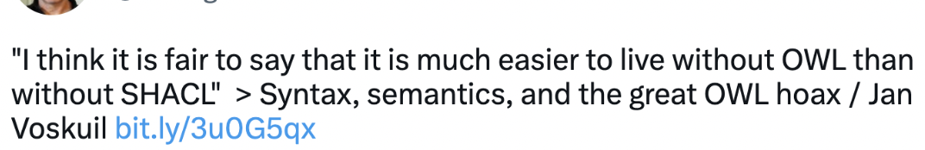
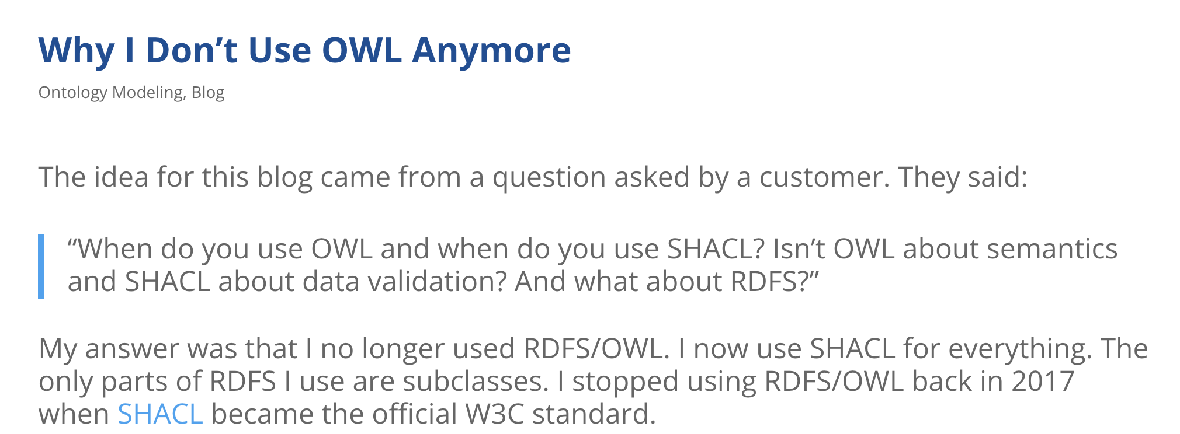

Previous iteration: OWL misused as schema language
https://twitter.com/aaranged/status/1485670670134497281
Lessons:
OWL is for modeling terminological knowledge
OWL is not a language to describe data
Description Logics
Semantic schema planet
Model of information
Temperature: cool
Notes:
TODO: adjust text

Slide 46
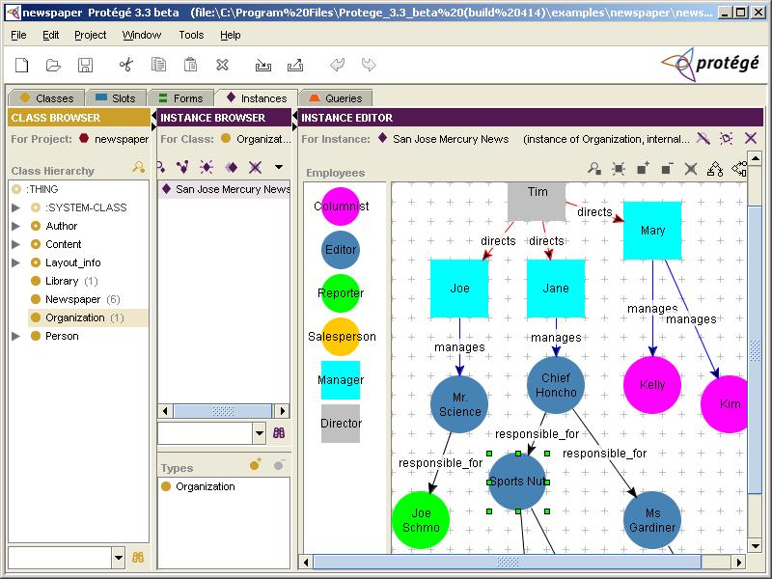
Previous iteration: Frames 1990s-2000s
OWL succeeded DAML+OIL
DAML normally frame-like
Frames
Semantic schema planet
Model of information
Temperature: cool

Slide 47

Previous revolution: Frames 1970s-1990s
A Framework for Representing Knowledge: Minsky, M. MIT-AI Laboratory Memo 306, June, 1974
Frames
Semantic schema planet
Model of information
Temperature: cool
Lehmann, F. Semantic Networks. Computers Math. Applic. 23(2-5), 1-50, (1992) https://doi.org/10.1016/0898-1221(92)90135-5

Slide 48


We need semantic standards!
>1800 Databases
>1k Ontologies
>1500 Standards
~13.5m terms

Slide 49
Most data standards are underspecified
Most standards in fairsharing don’t have an associated schema or validator
If you’re lucky:
XML Schema (older)
JSON Schema (newer)
Bindings to ontology terms are frequently unclear
Notes:
TODO: split

Slide 50
Most data standards are underspecified
Most standards in Fairsharing don’t have an associated schema or validator
If you’re lucky:
XML Schema (older)
JSON Schema (newer)
Bindings to ontology terms are frequently unclear
What about ShEx/SHACL standards?
Most data in the biosciences not shared as RDF
Some (e.g BioPAX) are really XML standards
Notes:
TODO: split

Slide 51




Lack of adherence to schemas limits meta-analyses
Actual data!
Biosample metadata
Metagenome standards analysis findings:
Standards are underspecified
Not machine actionable
Public data has poor conformance
Data too noisy for environmental meta-analyses
Notes:
TIMEPOINT: 40m

Slide 52


LinkML: Linked Data Modeling Language
id: https://example.org/linkml/hello-world
title: Really basic LinkML model
name: hello-world
version: 0.0.1
prefixes:
linkml: https://w3id.org/linkml/
sdo: https://schema.org/
ex: https://example.org/linkml/hello-world/
default_prefix: ex
default_curi_maps:
- semweb_context
imports:
- linkml:types
classes:
Person:
description: Minimal information about a person
class_uri: sdo:Person
attributes:
id:
identifier: true
slot_uri: sdo:taxID
first_name:
required: true
slot_uri: sdo:givenName
multivalued: true
last_name:
required: true
slot_uri: sdo:familyName
knows:
range: Person
multivalued: true
slot_uri: foaf:knows
Create data models in simple YAML files, optionally annotated using ontologies
https://linkml.io
https://github.com/linkml/linkml

Slide 53

LinkML: Easy for all
id: https://example.org/linkml/hello-world
title: Really basic LinkML model
name: hello-world
version: 0.0.1
prefixes:
linkml: https://w3id.org/linkml/
sdo: https://schema.org/
ex: https://example.org/linkml/hello-world/
default_prefix: ex
default_curi_maps:
- semweb_context
imports:
- linkml:types
classes:
Person:
description: Minimal information about a person
class_uri: sdo:Person
attributes:
id:
identifier: true
slot_uri: sdo:taxID
first_name:
required: true
slot_uri: sdo:givenName
multivalued: true
last_name:
required: true
slot_uri: sdo:familyName
knows:
range: Person
multivalued: true
slot_uri: foaf:knows
Create data models in simple YAML files, optionally annotated using ontologies
dct:creator
Biocurator
Data Scientist
https://linkml.io
https://github.com/linkml/linkml

Slide 54




LinkML: Polyglot modeling
Create data models in simple YAML files, optionally annotated using ontologies
Compile to other frameworks
dct:creator
Biocurator
JSON-Schema
Data Scientist
“Traditional” Applications and Infrastructure
Python Dataclasses
https://linkml.io
https://github.com/linkml/linkml
SQL DDL
TSVs

Slide 55


LinkML: Bridges semantic frameworks
Create data models in simple YAML files, optionally annotated using ontologies
Compile to other frameworks
Choose the right tools for the job, no lock in
OWL
Semantic Web Applications
And Infrastructure
dct:creator
ShEx, SHACL
Biocurator
JSON-LD Contexts
JSON-Schema
Data Scientist
“Traditional” Applications and Infrastructure
Python Dataclasses
https://linkml.io
https://github.com/linkml/linkml
SQL DDL
TSVs

Slide 56
Annotate schemas with ontologies
id: https://example.org/linkml/hello-world
title: Really basic LinkML model
name: hello-world
license: https://creativecommons.org/publicdomain/zero/1.0/
version: 0.0.1
prefixes:
linkml: https://w3id.org/linkml/
sdo: https://schema.org/
ex: https://example.org/linkml/hello-world/
default_prefix: ex
default_curi_maps:
- semweb_context
imports:
- linkml:types
classes:
Person:
description: Minimal information about a person
class_uri: sdo:Person
attributes:
id:
identifier: true
slot_uri: sdo:taxID
first_name:
required: true
slot_uri: sdo:givenName
multivalued: true
last_name:
required: true
slot_uri: sdo:familyName
knows:
range: Person
multivalued: true
slot_uri: foaf:knows
Export data to RDF and JSON-LD
>> Make the meaning of your schema more explicit
>> Data integration hooks

Slide 57



Easy ontology support via value sets

Slide 58



Easy ontology support via value sets
Notes:
TIMEPOINT: 45m

Slide 59


Model Serializations
LinkML Model (YAML)
Classes:
Person:
Slots:
age_in_years:
range: integer
ShEx, SHACL
SQLDDL
<Person> CLOSED {
( $<Person_tes> ( <age_in_years> @linkml:Integer ? ;
}
CREATE TABLE "Person" (
age_in_years INTEGER
)

Slide 60
Instance data as JSON/YAML, RDF, or TSV
python
from examples.basic import Person
from linkml.dumpers import json_dumper, rdf_dumper
sam = Person("1172438", first_name=["Samual", "J"], last_name="Snooter")
ann = Person("17a3923", first_name="Jill", last_name="Jones", knows=[sam.id])
print(json_dumper.dumps(ann))
print(yaml_dumper.dumps(ann))
print(rdf_dumper.dumps(ann, contexts="../examples/jsonld/basic.context.jsonld"))
JSON output
YAML output
RDF output
{
"id": "17a3923",
"first_name": [
"Jill"
],
"last_name": "Jones",
"knows": [
"1172438"
],
"@type": "Person"
}
id: 17a3923
first_name:
- Jill
last_name: Jones
knows:
- '1172438'
@prefix foaf: <http://xmlns.com/foaf/0.1/> .
@prefix sdo: <https://schema.org/> .
<https://example.org/linkml/hello-world/17a3923> a sdo:Person ;
foaf:knows <https://example.org/linkml/hello-world/1172438> ;
sdo:familyName "Jones" ;
sdo:givenName "Jill" .
Ongoing: coordinating with HDMF group on HDF5 readers/writers
‹#›

Slide 61












Ecosystem
DataHarmonizer
docgen
LinkML-Datalog
LinkML-OWL
schemagen
codegen

Slide 62













LinkML adoption

Slide 63

Environmental microbiome data
Notes:
TODO

Slide 64



Open, active, helpful, inclusive community
https://github.com/linkml/linkml/graphs/contributors
Notes:
TIMEPOINT: 50m

Slide 65


Planet Large Language Model
Large Language Model planet
Model of words
Temperature: ultra hot
LLMs

Slide 66

LLMs lack semantic understanding
Large Language Model planet
Model of words
Temperature: ultra hot
LLMs
Notes:
TODO: emphasize iteration and imbuing LLMs with semantics

Slide 67
OntoGPT: using LLMs with semantic structures
Ontology layer onto OpenAI GPT-3 API
Integrates prompt engineering, semantic data models, ontology annotation, and OWL translation
Components:
SPIRES: Stochastic Parrot Interrogation and Recursive Extraction of Semantics
HALO: Hallucinating Latent Ontologies
Authoring KGs with copilot
https://github.com/monarch-initiative/ontogpt

Slide 68

SPIRES: Stochastic Parrot Interrogation and Recursive Extraction of Semantics
Input: LinkML Schema
Nested/Compositional
Annotated with ontology metadata (e.g. FOODON)
Schema can be nested; e.g
Recipe has Step
Step has utensils, actions, input, output
Input has foodtype, quantity
Notes:
TODO

Slide 69
SPIRES: Stochastic Parrot Interrogation and Recursive Extraction of Semantics
On medium heat melt the butter and sauté the onion and bell peppers.
Add the hamburger meat and cook until meat is well done.
Add the tomato sauce, salt, pepper and garlic powder.
Salt, pepper and garlic powder can be adjusted to your own tastes.
Cook noodles as directed.
Mix the sauce and noodles if you like, I keep them separated
INGREDIENTS
UNITS: US
1 small onion (chopped)
1 bell pepper (chopped)
2 tablespoons garlic powder
3 tablespoons butter
1 teaspoon salt
1 teaspoon pepper
2 (15 ounce) cans tomato sauce
1 (16 ounce) box spaghetti noodles
1 - 1 1⁄2 lb hamburger meat.
Input: LinkML Schema
Nested/Compositional
Annotated with ontology metadata (e.g. FOODON)
Input: Unstructured text
E.g recipe, abstract
Notes:
TODO

Slide 70



SPIRES: Stochastic Parrot Interrogation and Recursive Extraction of Semantics
Unstructured Text
Prompt
Extract from the above text the following key-value pairs…
Input: LinkML Schema
Nested/Compositional
Annotated with ontology metadata (e.g. FOODON)
Input: Unstructured text
E.g recipe, abstract
Process:
Recursively query GPT3 via prompts
Annotate using OAK and Bioportal
(Map results to OWL)
JSON/RDF/OWL
Notes:
TODO

Slide 71

SPIRES: Stochastic Parrot Interrogation and Recursive Extraction of Semantics
Input: LinkML Schema
Nested/Compositional
Annotated with ontology metadata (e.g. FOODON)
Input: Unstructured text
E.g recipe, abstract
Process:
Recursively query GPT3 via prompts
Annotate using OAK and Bioportal
(Map results to OWL)
Output:
Nested JSON/RDF
(OWL TBox model)
Notes:
TODO

Slide 72

Standard schemas in life sciences, 1990s
The Life Sciences Research (LSR) group is a consortium of people representing pharmaceutical companies, academic institutions, software vendors and hardware vendors from all over the world who are working together within the Object Management Group (OMG) to improve communication and interoperability among computational resources in life sciences research
Mission:
To improve the quality and utility of software and information systems used in Life Sciences Research through use of the Model Driven Architecture (MDA), OMG technologies such as UML and CORBA, and MDA-supported technologies such as XML and EJB
https://web.archive.org/web/20080828214226/http://www.mged.org/Meetings/presentations/OMG/sld019.htm
Notes:
TIMEPOINT: 55m

Slide 73

Standard schemas in life sciences, 1990s
https://web.archive.org/web/20170922215834/http://www.omg.org/lsr/FAQ.html#why%20succeed

Slide 74
Conclusions
Embrace change
Don’t be wedded to any one technology stack
Why can’t BigTable, Neo4j, etc have semantics?
We need to scale up semantics to cover ALL the data
This requires an open, inclusive approach
Notes:
TODO

Slide 75
Acknowledgments
OBO and Ontologies
OBO Operations Group, James Overton, Nico Matentzoglu, Bjoern Peters
Gene Ontology Consortium, Ben Good, Seth Carbon, Laurent-Philippe Albou, Tremayne Mushayaham, Dustin Ebert,Peter d’Eustachio, David Hill, Pascale Gaudet, Paul D Thomas
Biolink, Translator, and KG-Hub:
NCATS Translator Data Modeling Group, Chris Bizon, Nomi Harris, Mike Bada, Matt Brush, Deepak Unni, Sierra Moxon
KG-Hub group, Peter Robison, Melissa Haendel, David Osumi-Sutherland, Kevin Shafer, Marcin Joachimiak, Seth Carbon, Tim Putman, Luca Cappalletti, Justin Reese
LinkML:
LinkML community and developer group, Harold Solbrig, Sierra Moxon, Mark Miller, Sujay Patil
OntoGPT:
Harry Caufield, Harshad Hegde

